Slide 1
Version Control
SDLC
Pham Van Minh Duc – GCD17053

Slide 2
What is Version Control?
A component of software configuration management, version control, also known as revision control or source control, is the management of changes to documents, computer programs, large websites, and other information collection. Changes are usually identified by a number or letter code, called the "revision number", "revision level" or simply "revision". For example, an initial set of files is "version 1". When the first change is made, the result set is "version 2", .... Each modification is associated with the timestamp and the person making the change. Revisions can be compared, restored, and with some file types,

Slide 3
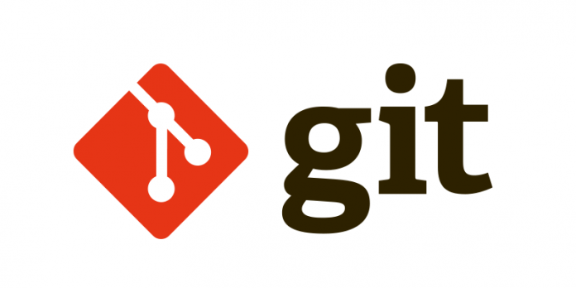
What are the tools available for version control?
1. git
Git is distributed source management software developed by Linus Torvalds in 2005, originally for the development of the Linux kernel. Today, Git has become one of the most popular source code management software. Git is open source software distributed under the GPL2 public license

Slide 4


2. CVS
CVS is the script for Concurrent Versions System. CVS means "agree and written". The word CVS named in the software is the concurrent version system. Love, finance, culture and culture, finance, culture, finance, culture, culture. CVS for selecting many of the different applications. CVS can only be used in their software.
2. Mercurial
Mercurial is a free, distributed source control management tool. It efficiently handles projects of all sizes and provides easy and intuitive interface.

Slide 5
3. Bazaar
Bazaar is distributed version control system, which also provides a great, friendly user experience. Bazaar is unique that it can be deployed either with a central code base or as a distributed code base.

Slide 6
The main advantage are
Automatic backups: If you accidentally delete some file (or part of a file) you can undelete it. If you change something and want to undo it, the VCS can do so.
Sharing on multiple computers: VCSes are designed to help multiple people collaboratively edit text files. This makes sharing between multiple computers (say your desktop and laptop) particularly easy.
Version control and branching: Say you published some class notes as a pdf and want to fix some typos in them while simultaneously working on the notes for next year.

Slide 7
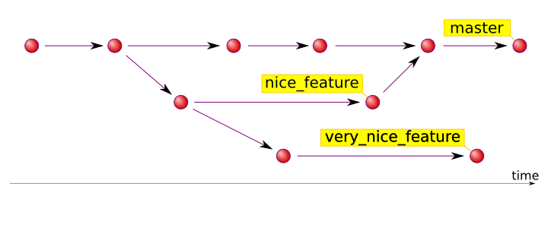

Slide 8
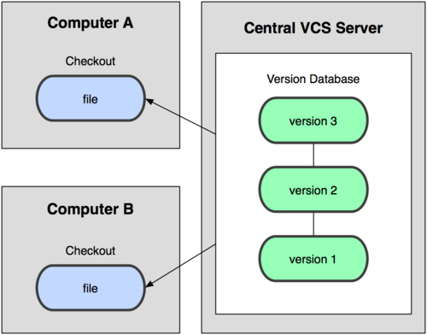

Slide 9
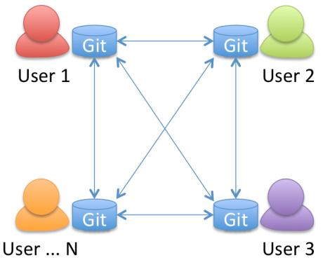

Slide 10
